Slide 1

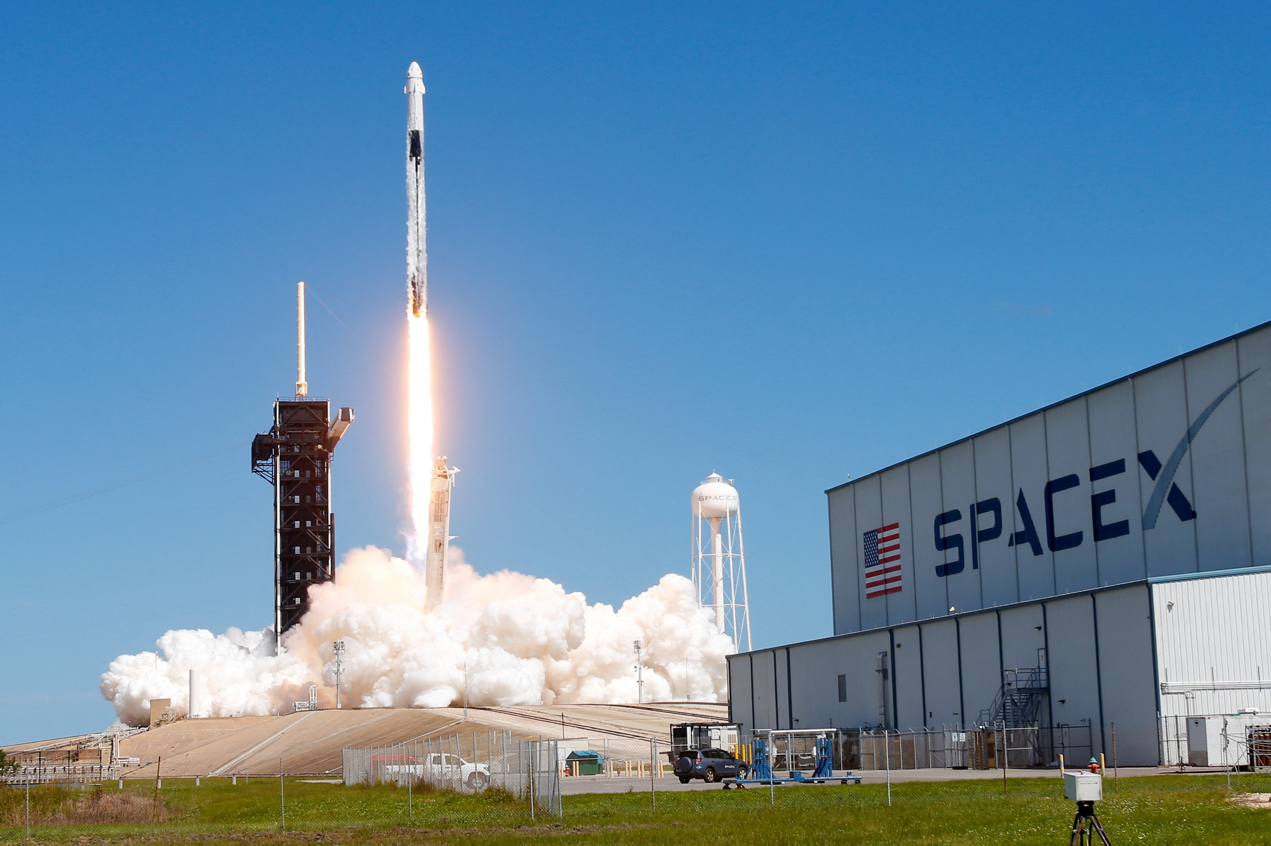
IBM Data Science Capstone Project
Schäfer, Dennis
November 01st, 2022
Notes:
© Copyright PresentationGO.com – The free PowerPoint and Google Slides template library

Slide 2
Outline
Executive Summary
Introduction
Methodology
Results
Conclusion
Notes:
© Copyright PresentationGO.com – The free PowerPoint and Google Slides template library

Slide 3
Executive Summary
Methodologie
Data Collection
Data Wrangling
Data Analysis
EDA with SQL
Predictive Analysis
Results
Exploratory Data Analysis with Data Visualization
Interactive map with Folium
Predictive Analysis
Notes:
© Copyright PresentationGO.com – The free PowerPoint and Google Slides template library

Slide 4
Introduction
Notes:
© Copyright PresentationGO.com – The free PowerPoint and Google Slides template library

Slide 5
Project backround
We are working for the company SpaceY and are analysing the data of the company SpaceX adverstised on its website
The Falcon 9 rocket launches costs around 100 million dollars less throught SpaceX can reuse the first stage
The goal is to predict if the Falcon 9 will land successfully
Notes:
© Copyright PresentationGO.com – The free PowerPoint and Google Slides template library

Slide 6
Problems
What influences the success of the rocket landing?
Under what conditions does the rocket launch has the best success rate?
What is the best model to predict further rocket launches
Notes:
© Copyright PresentationGO.com – The free PowerPoint and Google Slides template library

Slide 7
Methodology
Notes:
© Copyright PresentationGO.com – The free PowerPoint and Google Slides template library

Slide 8
Data Collection
Web Scrapping Wikipedia using BeautifulSoup
SpaceX REST API
Using the following URL: https://api.spacexdata.com/v4/launches/past
Provides data about rocket launches including detailed information
Normalize the data into a .csv file for further analysis

Slide 9
Data Wrangling
Convert a succeed and failed landing with numeric for futher steps
Create a new column named „Class“
If the landing succeed assign 1 to the column „Class“, otherwise assign 0

Slide 10
Data Analysis
Exploratory Data Analysis with Data Visualization
Using scatter graphs, bar graph and line graph
Creating an interactive map with Green and Red markers assigned from the column „Class“
Creating an interactive dashboard to access filtered information

Slide 11
Predictive Analysis
Building the model with a 20% test data set
Check the accuracy for each model
Plot Confusion Matrix

Slide 12
Results
Notes:
© Copyright PresentationGO.com – The free PowerPoint and Google Slides template library

Slide 13
Exploratory Data Analysis with Data Visualization

Slide 14
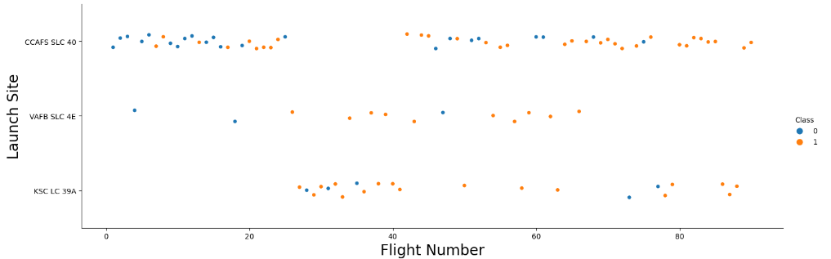
Launch Site vs Flight Number
The the flight number scales with the success rate
CCAFS SLC 40 has a lower success rate

Slide 15
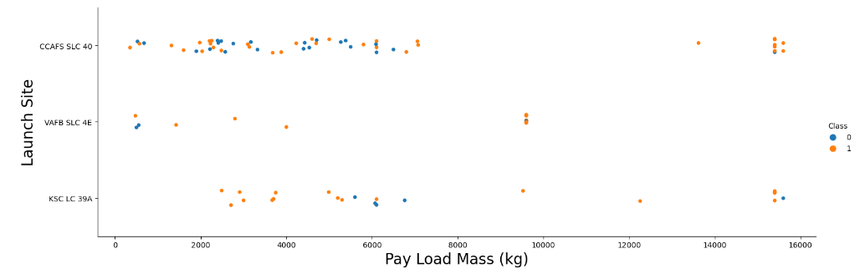
Launch Site vs Pay Load Mass (kg)
Higher Pay Load Mass has a higher success rate
For KSC LC 39A a very low Pay Load Mass has a higher success rate

Slide 16
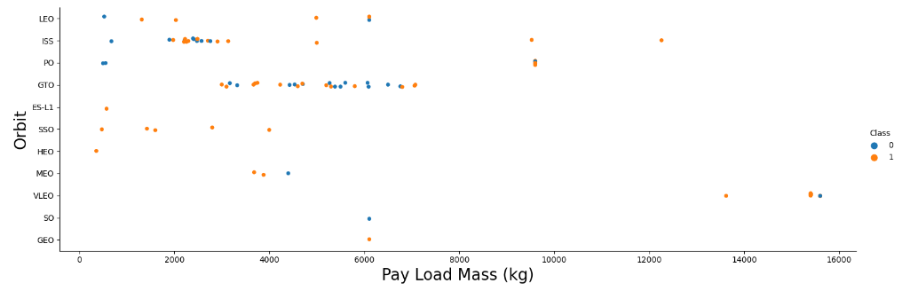
Orbit vs Pay Load Mass (kg)
The Pay Load Mass inbetween one Orbit does not have a significant difference.

Slide 17
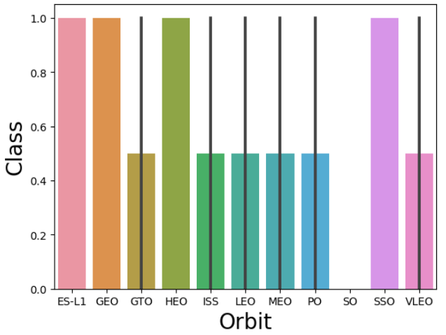
Mean of the Orbits success rate
ES-L1, GEO, HEO and SSO has the best success rate
SO has a very poor success rate

Slide 18
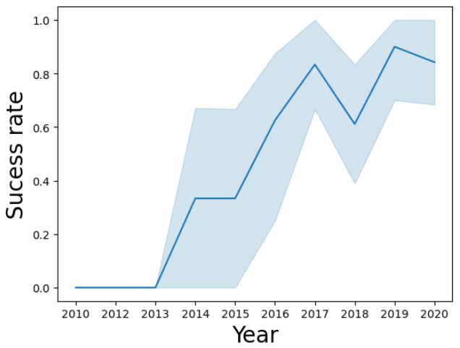
Success rate vs Year
The success rate is increasing nearly till 2020.

Slide 19
EDA with SQL

Slide 20

Unique launch sites
%sql SELECT
DISTIONCT(LAUNCH_SITE)
FROM SPACEXTBL

Slide 21
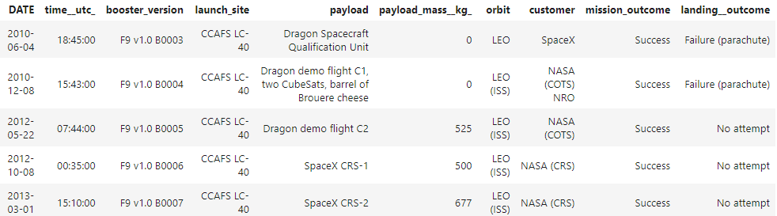
5 records with „CCA“ launch sites beginning
%sql SELECT * FROM SPACEXTBL WHERE LAUNCH_SITE LIKE „CCA%“ LIMIT 5

Slide 22

Total mass carried by booster launched by NASA (CRS)
%sql SELECT SUM(PAYLOAD_MASS_KG) FROM SPACEXTBL WHERE CUSTOMER = „NASA (CRS)“

Slide 23

Average payload mass carried by boster version F9 v1.1
%sql SELECT AVG(PAYLOAD_MASS_KG) FROM SPACEXTBL WHERE BOOSTER_VERSION = „F9 v1.1“

Slide 24

Date of the first successful landing outcome in ground pad was acheived
%sql SELECT MIN(DATE) FROM SPACEXTBL WHERE LANDING__OUTCOME = „SUCCESS (ground pad)“

Slide 25
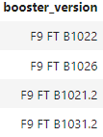
Booster versions with successes and a payload mass between 4000 and 6000
%sql SELECT BOOSTER_VERSION FROM SPACEXTBL WHERE LANDING__OUTCOME = „SUCCESS (drone ship)“ AND PAYLOAD_MASS_KG > 4000 AND PAYLOAD_MASS_KG < 6000

Slide 26

Total number of successful and failure mission outcomes
%sql SELECT COUNT(MISSION_OUTCOME) FROM SPACEXTBL WHERE MISSION_OUTCOME = „Success“ OR MISSION_OUTCOME = „Failure (in flight)“

Slide 27
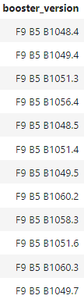
Booster_versions which has carried maximum payload mass
%sql SELECT BOOSTER_VERSION FROM SPACEXTBL WHERE PAYLOAD_MASS_KG = (SELECT MAX(PAYLOAD_MASS_KG) FROM SPACEXTBL)

Slide 28
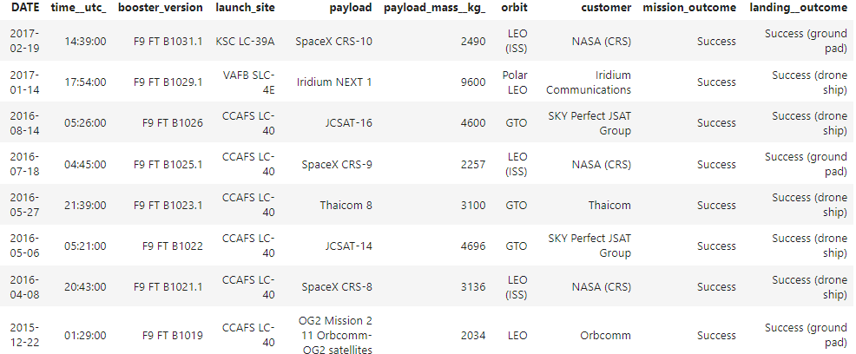
Landing_outcomes between the date 2010-06-04 and 2017-03-20 in desc order
%sql SELECT * FROM SPACEXTBL WHERE LAUNCH_OUTCOME LIKE „Success%“ AND (DATE BETWEEN „2010-06-04“ AND 2017-03-20“) ORDER BY DESC

Slide 29
Interactive map with Folium

Slide 30
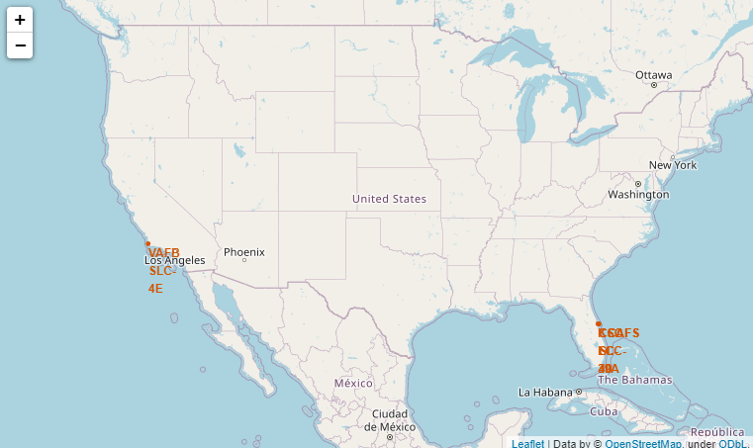
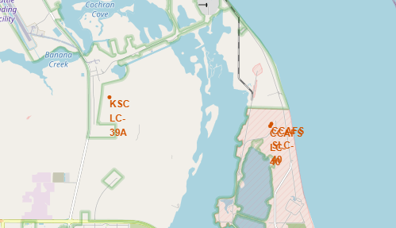
All launch sites

Slide 31
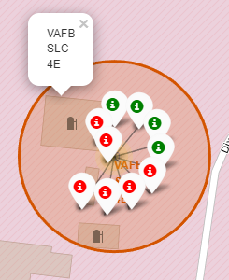
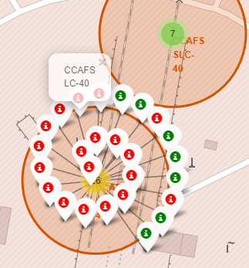
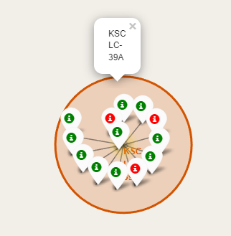
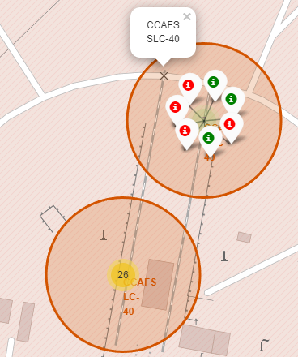
Success und fail landing marks
Green marks a succeed landing and Red marks a failed landing.

Slide 32
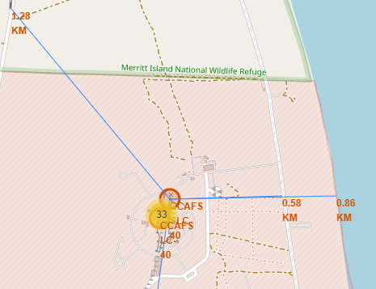
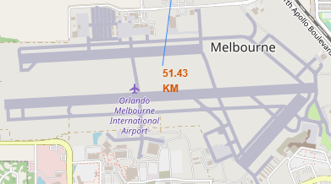
Success und fail landing marks
Distance to the closest Highway, coast, rails and airport

Slide 33
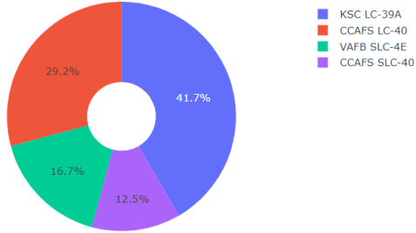
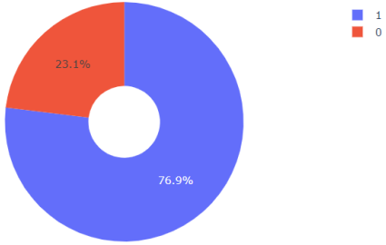
Dashboard – Pie Chart
Success rate all Launches
KSC LC-39A success rate

Slide 34
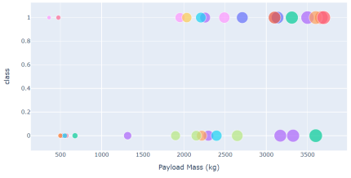
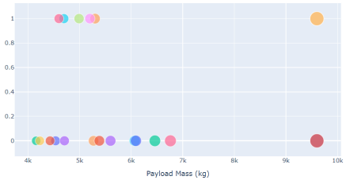
Dashboard – Scatter Plot
Light Payload max 4000 kg
Heavy Payload min 4000 kg

Slide 35
Predictive analysis
Classification models

Slide 36
Classification accuracy using models
Performing accuracy tests on the following models
K-nearest Neighbors (KNN)
Support Vector Machine
Linear Model (Logistic Regression classifier)
Decision Tree Model
The Decision Tree has the highest accuracy

Slide 37
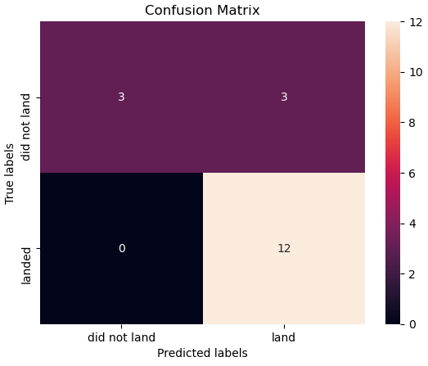
Confusion Matrix for the tree
After Examination we see problems in the row „did not land“ for the actual values.

Slide 38
Conclusion
Notes:
© Copyright PresentationGO.com – The free PowerPoint and Google Slides template library

Slide 39
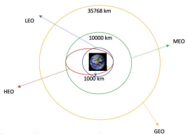
Conclusion
Higher Pay Load Mass performs better than lighter Pay Load Mass, except for KSC LC 39A
Orbits ES-L1, GEO, HEO and SSO has the best success rate
Success rate of SpaceX increases with time in years
The Decision Tree Model works the best for this dataset

Slide 40
Thank You!
Notes:
© Copyright PresentationGO.com – The free PowerPoint and Google Slides template library

